Slide 1
Capacity Management for VMs Right Amount, Usage, Platform Presented by: Bryan Semple, Chief Marketing Officer, VKernel

Slide 2
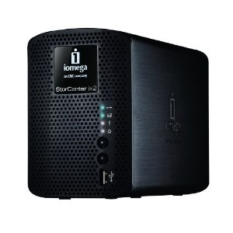
2 TB NAS
Fill out form
Check your email tonight/tomorrow
Also links to white papers and other useful information

Slide 3
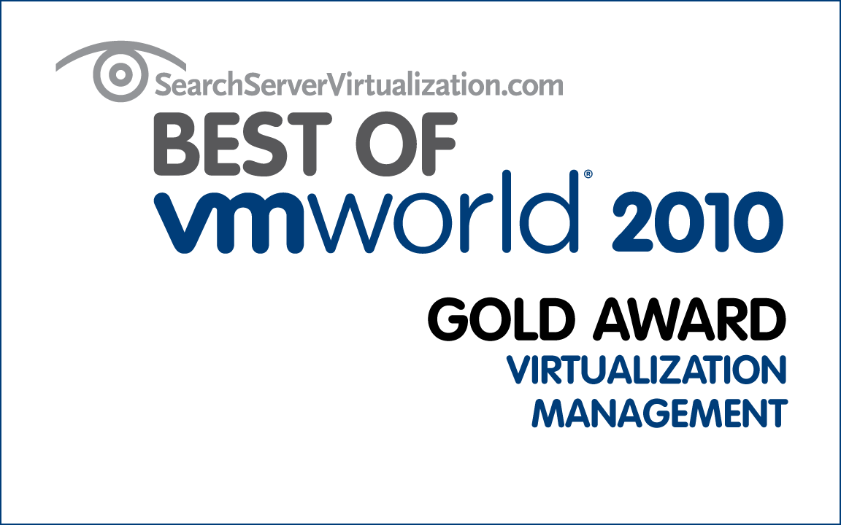
#1 Provider of Capacity Management Solutions for Virtualized Environments
Founded April, 2007
Management team w/ track record of success
Profitable and growing
Shipped 1st product in April 2008
50,000+ users, 700+ customers, worldwide footprint
Nearly 3x yr/yr revenue growth
55 employees
Recognized and established industry leader
10 virtualization
vendors to watch

Slide 4
Incorrect Capacity Decisions Can Have Dramatic Impact
Wrong amount – too much/too little
Performance impact
Cost impact
Wrong usage – sprawl, waste, powered off
Cost impact
Wrong platform – scale up or scale out
Cost impact
Availability impact
Goal – Just the right amount of capacity, with minimal waste, deployed using the most cost efficient platform
Maximum performance
Lowest possible cost

Slide 5
Matching Capacity to Performance Used to Be Easy
Application & resources used to be one-to-one
Dedicated CPU & memory
Local storage
Problems are localized
Numbers, not complexity

Slide 6
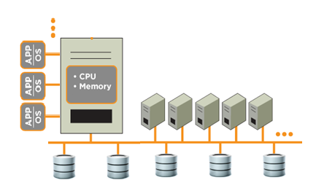
Virtualized Data Center Enables Resource Contention
Shared resources
CPU
Memory
Storage
Network
Dynamic
vMotion
vMotion for storage
DRS
Self service portals

Slide 7
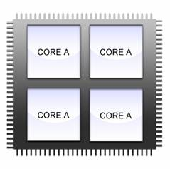
Some CPU Basics
CPU Utilization
CPU Ready
CPU Sizing
Typical to see over allocation
VM1
VM1
0
1
VM2
VM2
2
3
VM3
VM4
VM4
VM4
VM4
Notes:
Environments will have a variety of VM sizes.

Slide 8
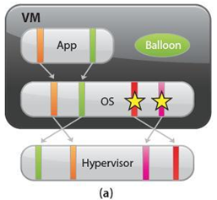
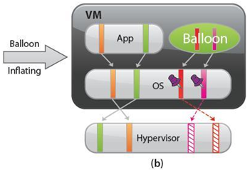
Memory Basics
Memory allocation not as straightforward
VMs hesitant to return unused memory
Memory ballooning
Memory swapping
Active memory vs. consumed memory
#1 constraint
Notes:
When a VM is given memory, it doesn’t naturally give it back to the hypervisor when it doesn’t need it anymore.
Host memory reclamation to give redirect memory pages as necessary
There’s several different ways now, but here’s a couple of primary methods that can impact performance.
One way can be normally and harmless, while the other is completely detrimental.
Steps
sets size for balloon driver
balloon driver requests memory from the guest
Watch for memory limits
Hypervisor swapping
No regard for what memory pages it takes

Slide 9
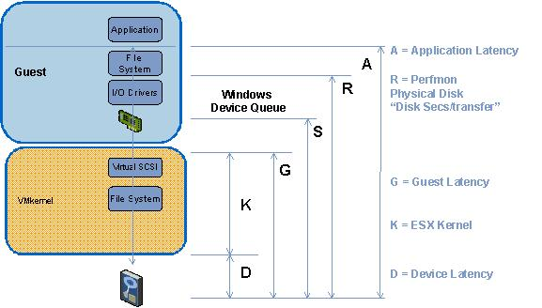
Storage and Network Challenges
KAVG
Kernel Latency
DAVG
Command Latency
GAVG
Guest Latency
Now add SAN, controller, disk contention and latency
Notes:
How many of you manage your own storage?
How many of you have a separate person or team that manages the storage for the virtualization environment?
ESX Top Metrics for Latency and IOPS
DAVG = Command Latency
KAVG = Queue Latency
GAVG = combination of both
10 ms for sustained periods of time
All arrays perform differently
Different applications are more senstive to latency than others
What works best for you
What is bad?

Slide 10
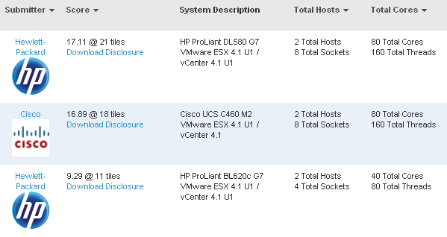
The Core Challenge

Slide 11
Monitoring the 20 Metrics
CPU
Memory
cpu.extra.summation
cpu.ready.summation
cpu.usagemhz.average
mem.active.average
mem.consumed.average
mem.overhead.average
mem.swapin.average
mem.swapout.average
mem.swapped.average
mem.vmmemctl.average
Disk
disk.read.average
disk.write.average
disk.queueLatency.average
disk.totalLatency.average
disk.commandsAborted.summation
disk.busResets.summation
Network
net.received.average
net.transmitted.average
net.usage.average
Notes:
“The Top 19 vCenter Metrics” sounded kind of funny and made our marketing people cringe.

Slide 12
Solution – Analyze Key Performance Metrics

Slide 13
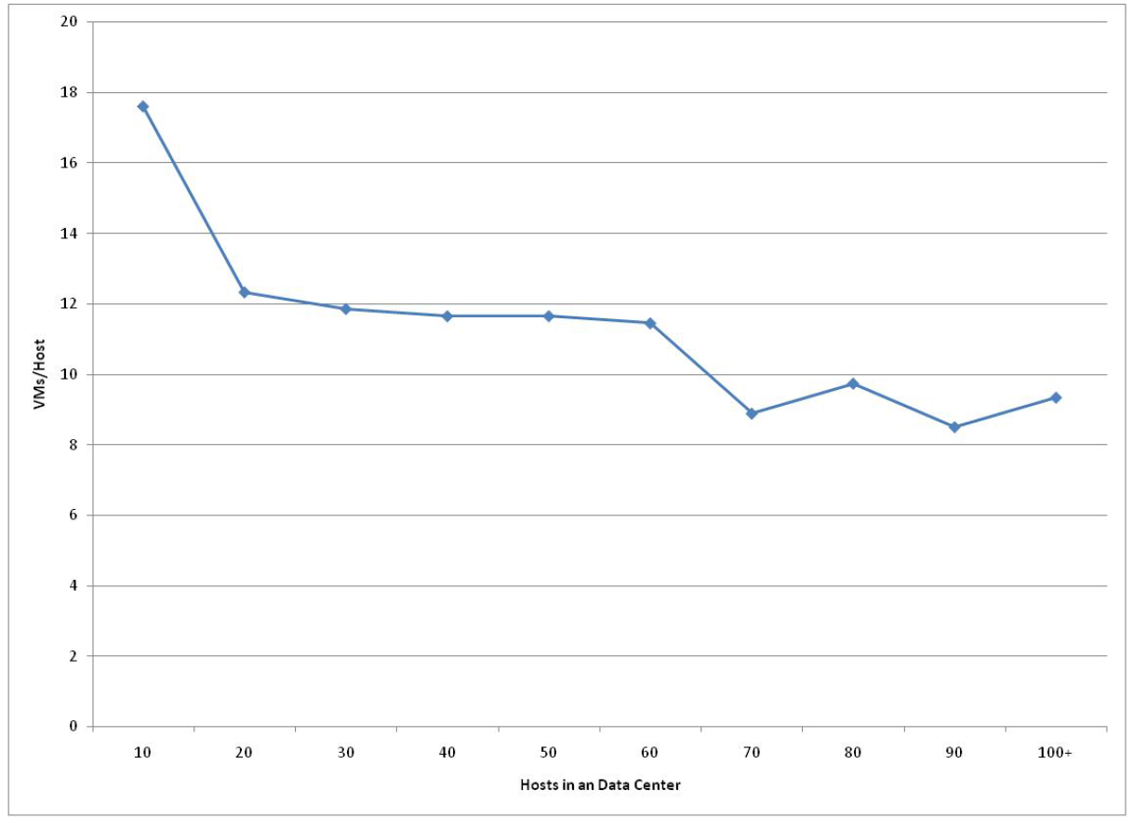
More Likely Impact – Too Much Capacity
Lack of analytics for planning
Concern over performance drives over capacity

Slide 14
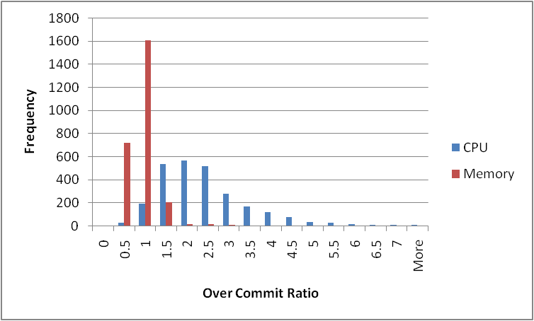
CPU is Over Allocated, Memory is Not
0.7 Average Over Commit Memory
2.2 Average Over Commit CPU

Slide 15
Low Density 50% Cost Premium – CFO Response?
 | High Density | Average
VMs/Host | 20 | 10
Hosts Req (100vms) | 5 | 10
Server Capex | 20,000 | 20,000
Three Year Opex | 15,000 | 15,000
Capex and Opex | 35,000 | 35,000
Total | $175,000 | $350,000
Three Year VM Cost | $1,750/VM | $3,500/VM
Cost Advantage | 50% | 0%

Slide 16
Hardware Gains Have Really Driven Consolidation Advances
Average:
VMs/vCPU is .9
CPU/core is 2.2
Current sharing is only about 2 VMs/core
More cores/host to drive compression vs. proactively driving out costs
Virtualization provides mainframe like efficiency yet we are stuck in physical world capacity planning
Problem will only get worse

Slide 17
Solution – Best Placement and Optimize

Slide 18
Incorrect Capacity Decisions Can Have Dramatic Impact
Wrong amount – too much/too little
Performance impact
Cost impact
Wrong usage – sprawl, waste, powered off
Cost impact
Wrong platform – scale up or scale out
Cost impact
Availability impact

Slide 19
Capacity Gets Deployed for Non-Productive Work
Always storage, but also CPU memory
Reserved for VMs or remnants that are no longer doing useful work
Perception that VMs are free
Self-service portals
Test and dev environments
VM abandonment
Poor operational processes

Slide 20
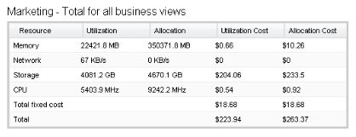
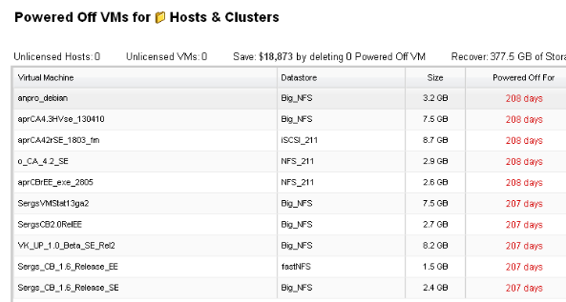
Eliminating Waste
Waste finding
Abandoned images
Unused templates
Unused snapshots
Powered off
ZombieVMs
Chargeback
Show back for budgeting

Slide 21
Incorrect Capacity Decisions Can Have Dramatic Impact
Wrong amount – too much/too little
Performance impact
Cost impact
Wrong usage – sprawl, waste, powered off
Cost impact
Wrong platform – scale up or scale out
Cost impact
Availability impact

Slide 22
Scale up or Scale Out?
1,000 VMs
Average peak CPU cycles required 1.2 GHz
Average peak memory required 1 GB
Assume cluster size of 5 with 25% failover reserve
Pay premium for high density memory, fastest CPUs, densest cores
Scale up and scale out concerns
What server has the lowest cost for this data center?
Model | Size | Sockets | Cores | CPU (GHz) | Memory (GB) | Cost (includes ESX)
R610 – 2x4 - 96 | 1U | Dual | Dual | 2.4 | 96 | $20,415
R610 – 2x4 - 192 | 1U | Dual | Dual | 2.4 | 192 | $31,597
R610 – 2x4 (3.4) - 96 | 1U | Dual | Dual | 3.46 | 96 | $27,784
R900 – 4x4 - 128 | 4U | Quad | Quad | 2.4 | 128 | $50,199
R900 – 4x6 - 256 | 4U | Quad | Six | 2.4 | 256 | $75,390

Slide 23
Example
1,000 VMs
Average peak CPU cycles required 1.2 GHz
Average peak memory required 1 GB
Assume cluster size of 5 with 25% failover reserve
What server has the lowest cost for this data center?
Model | Size | Sockets | Cores | CPU (GHz) | Memory (GB) | Cost (includes ESX)
R610 – 2x4 – 96 | 1U | Dual | Dual | 2.4 | 96 | $20,415
R610 – 2x4 – 192 | 1U | Dual | Dual | 2.4 | 192 | $31,597
R610 – 2x4 (3.4) – 96 | 1U | Dual | Dual | 3.46 | 96 | $27,784
R900 – 4x4 - 128 | 4U | Quad | Quad | 2.4 | 128 | $50,199
R900 – 4x6 - 256 | 4U | Quad | Six | 2.4 | 256 | $75,390

Slide 24
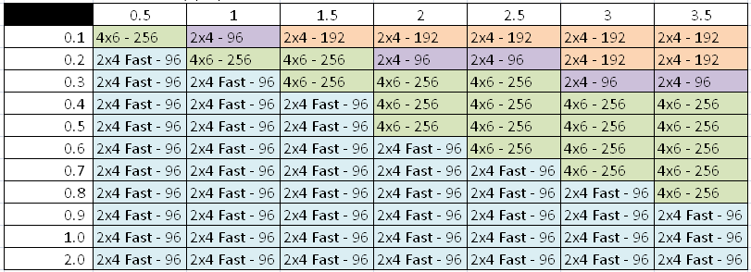
Cheap and Fast Wins the Day – Using Allocation as a Capacity Measure is Flawed
Average Peak Memory (GB)
Average Peak CPU (GHz)

Slide 25
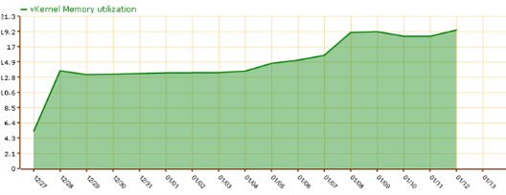
Solution – Understand Global Load, Purchase Cheapest Platform
Determine peak utilization for memory and CPU for each VM
Worse case scenario if all VMs hit peak at same time
Max memory and CPU capacity required across data center
Find least expensive servers to meet CPU and memory requirements

Slide 26
Keys to Capacity Management
Right amount of capacity to meet performance requirements
Contain sprawl and non-productive VMs
Deploy optimal scale up/scale out platforms based on demand

Slide 27
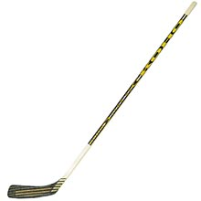
Scope of Capacity Management Challenges Still Increasing
The current problems are complex
Application criticality - performance at a premium
Dynamic VMs – vmotion, clusters, production/DR, cloud/private,
Virtual machines drive business agility
Simple cost reductions are gone
Moore’s Law – scale up/out, cluster size, fault tolerance, refresh cycles, non-linear Vmmarks

Slide 28
Questions?
Some possible next steps:
Download VKernel vOperations Suite (vOPS)
Will email 20 Metrics White Paper
Video of presentation
2 TB NAS drive drawing

